Slide 1


October 2022
October 2022
Team 4: Ankit Muthiyan, Krish Engineer, Kshitij Mahajan, Rochan Nehete, Viswatej Seela
The University of Texas at Austin

Slide 2
Today we’ll discuss…
Problem Statement​
Data source and pre-processing
Analysis
Results
Insights
Recommendations

Slide 3
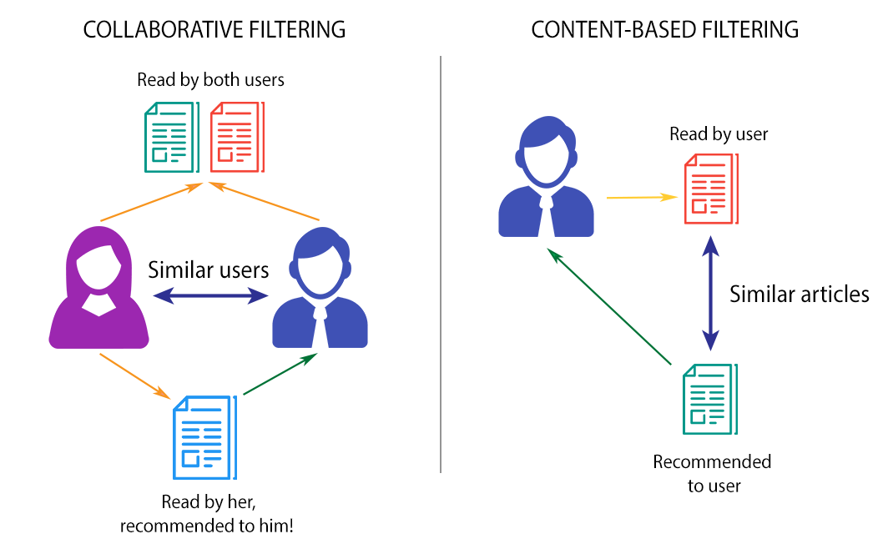
What are we trying to solve for…
We tend to like things that are similar to other things we like
Problem Statement: using variables like cast and genre to recommend underrated movies with a high similarity score, using a content-based approach
With the increasing number of options and data available, recommendation systems have become extremely popular

Slide 4

Data source and pre-processing
Source: Scraped 80000+ reviews from IMDb
9 variables: title, year, time, genre, rating, simple_desc, votes, director, cast
Cleaning of data: Selected a random sample of 20000 movies for computational efficiency, after removing duplicates, incomplete or erroneous entries
Purpose: to identify and recommend movies similar to each other based on the users input(movie name)

Slide 5
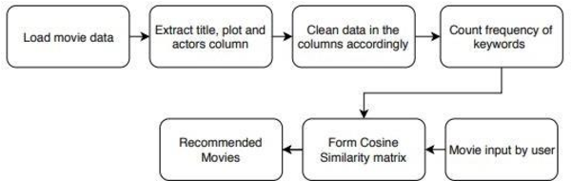
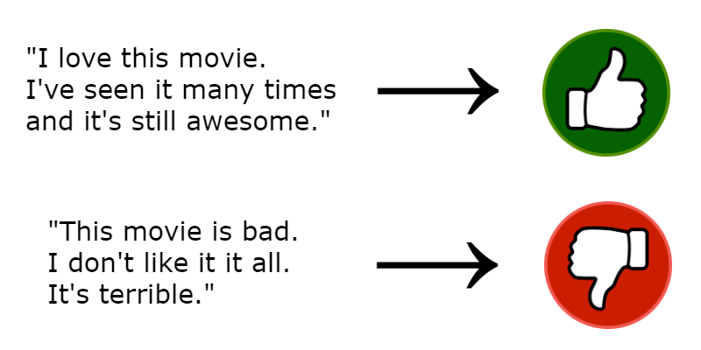
Analysis
Sentiment Analysis

Slide 6
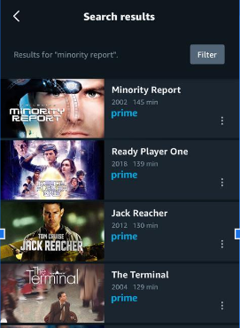
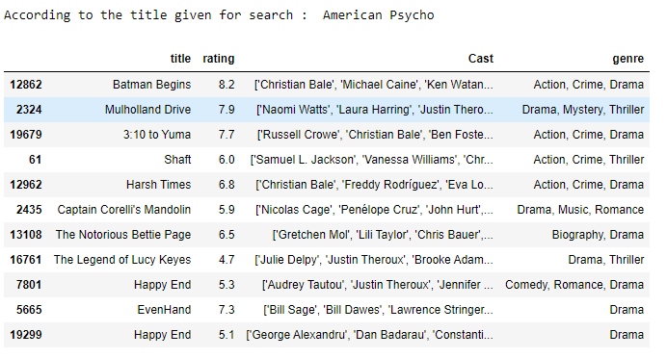
Results

Slide 7

Insights
Content based with genre or other available
attributes is good when a user has less
ratings
Movie similarity metric based on features like cast, director and genre
Combining the sentiments of the movie reviews and similarity scores of multiple columns gives better results in terms of accuracy and quality of recommendations.

Slide 8
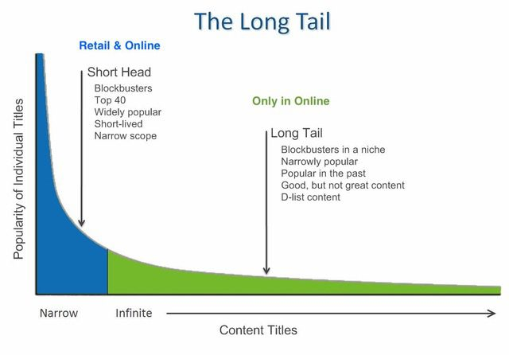
Recommendations / Future Scope
Introducing more features for achieving a higher recommendation accuracy
Using larger datasets
Defining different weights to features based
on user needs
As shown in the graph, recommend the
less popular movies present in the long tail

Slide 9
Thank You!

